Slide 1
Where will you go after Year 11?
How much money will you earn? Will you be successful? What are you good at?

Slide 2
Where to go?
There are lots of different places
that you can choose to study at for example…
SDC College
Exeter College
Plymouth College
Local 6th Form
Training Provider
Specialist Colleges Out of Area e.g.
Bicton, AFC Harrogate etc.
This presentation is not aimed at any particular place of study instead we are concentrating on the types of programme that you can participate in…

Slide 3
You have won the lottery!
The prize is….

Slide 4
A holiday in one of these places
Barbados
Australia
Which one will you choose?
South Africa
Belgium
England
Notes:
Vote on which one they want as their prize

Slide 5
Just found out more detail…
Explore ALL the information before you decide
Barbados
Packing bananas
Australia
Sheep-shearing
South Africa
Which place do you want to go now?
Cleaning toilets
Belgium
Testing chocolate
England
Glastonbury tickets
Notes:
Knowing the detail can make all the difference and that’s the same with choosing your career options, you need to know the detail, not just ‘I am going to go to college/sixth form’ but which course, where will it take you, etc.

Slide 6
Planning for the future...
Why it’s important....
You can discover new places to go and develop your skills.
You can make sure that you are staying on track with your goals.
You will make choices that are right for you.
You will feel great achievement and satisfaction when you accomplish your goals.
You will become self motivated.
You will have direction.
Notes:
“Career planning is not just making plans to obtain your “perfect” job or career, but to help you make the many adjustments there will be along the way as you learn about you and your world or work.”

Slide 7
Choosing options: what to think about
What grades are you likely to get at GCSE? (especially English and maths)
How do you like to learn e.g. by doing, by studying?
Some people start with a job they want to do in the future and look at what they need to do to get there.
Some people start with a subject they like and focus on jobs later.
There are lots of ways of getting to the same future job.
Notes:
What you need to think about

Slide 8
One place for all your careers information.
Pathways
At 16
Academic
Vocational
Work-based
Academic/ Work-based
A levels
Applied General: BTEC
Apprenticeships
T -Levels
Mostly in school, Sixth Forms and some colleges.
Mostly in colleges but offered in some schools and can be done alongside A Levels
Working for an employer with some time at a college or similar. Get paid.
Learning at College with 1 day on the job training
Need to have enjoyed your GCSE subjects, like independent study.
Need to be interested in a job area.
Need to know this is the job area you want to work in.
You will need 5 GCSEs grade 4 - 9 including English and Maths.
Exam assessment at the end of two years.
Course work, some final assessment and work placement.
Learning through doing the job, some time at a college or similar, some written assessment.
Course work, some final assessment and work placement.
Notes:
Full Time Education:
Staying on at school/Academy sixth form or an FE/sixth form college to study:
AS/A’ Levels
Vocational Qualifications such as BTECs
Foundation Learning programmes
GCSEs
Education & training for 16-18 year olds is free
Undertaking full time education can provide young people with the academic and/or vocational skills to progress into further/higher education or work with training

Slide 9
One place for all your careers information.
A Levels
Most schools / colleges expect you to have a 6+ in the A level you want to study. Including English Language and Maths
What grades do you usually need to do an A Level?
3 or 4
How many subjects do you study at A Level?
Some students study 4 subjects, whilst others study 3.
Can you do an apprenticeship after A Levels?
After A levels you could start an Advanced or Higher Apprenticeship
Notes:
Level 3 Courses.
All subjects involve terminal assessments i.e. exams after 2 Years
The As Level still exists but as a standalone qualification
Assessment by exam has increased and coursework has all but disappeared there are some exceptions to this such as Art and Music
The practical component of science A Levels no longer counts towards the final grade- There is a separate Pass/ Fail grade.

Slide 10
Apprenticeships- Work Based
£153.55 per week (but some employers pay more)
What is the basic pay for a 37 hour week?
What Level is an Advanced Apprenticeship?
Notes:
Daunting as it may be, if this is the route that you wish to take make sure you have planned in advance. There are very few vacancies at the moment,. Be sure to fill in applications thoroughly correct grammar and spelling are crucial. Apprenticeships...
Apprenticeships are an excellent way of gaining qualifications and workplace experience. As an employee, you can earn as you learn and you gain practical skills from the workplace.
Apprenticeships are available in a wide range of industry sectors, with over 190 job roles ranging from accountancy and engineering to veterinary nursing and floristry.
It is not easy to find apprenticeships in the current climate to see what is available locally you can log o to www.apprenticeships.org.uk

Slide 11
Vocational
What are the Levels?
Level 2 = 5 GCSES at grade 4/5
Level 3 (Diploma)= 2x A Levels
Level 3 (Extended Diploma) = 3 A Levels
3 or 4
How many subjects do you study?
One subject and English / Maths if you do not gain a grade 4+
Can you do an apprenticeship afterwards?
Yes and if you achieve a Level 3 you can study Higher Level Apprenticeships and degrees at University.
Notes:
Designed in partnership with employers, universities and professional or trade organisations- this means that you can develop the skills employers want.
You can gain knowledge needed to progress to a higher level – such as degree level courses or apprenticeships.
Btecs are great because.. They give you the broad knowledge and skills required to work in a range of jobs within an industry.
These courses will not prepare you for a specific role like an apprenticeship but will provide an insight to an industry and a vocational alternative to A Levels. They will include some work experience.

Slide 12
T Levels
Practical experience - 45 days paid work experience with a relevant employer.
Industry specific technical knowledge and experience.
Literacy, numeracy, digital skills and wider transferable skills.
2 Years of study
What do they involve?
3 or 4
How many subjects do you study?
T levels are available 25 different job sectors such as agriculture to catering, digital technologies to education. Design surveying and planning construction], digital production design and development [IT] and Education. e T level subjects available in the following subjects;
What do you do afterwards?
You will have the experience to progress onto a higher or degree apprenticeship or to be able to progress on to Higher Education in the job area you have trained in.
Notes:
Designed in partnership with employers, universities and professional or trade organisations- this means that you can develop the skills employers want.
You can gain knowledge needed to progress to a higher level – such as degree level courses or apprenticeships.

Slide 13
Making Choices
Making a decision can lead to both positive and negative outcomes. To reduce the possibility of a negative outcome, it is important that you gain as much information as you can.
Think about your likes and Dislikes
How you best learn
What you might like to do in the future
Be realistic

Slide 14
Think Ahead
Now is the time to Research and Plan…
Use the tools on the careers section of the school website, speak to staff, email any careers/ employment questions you may have to careers@paigntonacdemy.org
If you want to go to University you should be investigating what type of course would interest you or what course you will need to do in order to be employed in your chosen career. Use www.ucas.com

Slide 15
Applying
Make sure you submit early
(By Feb ½ term).
Check spellings and grammar.
Be honest.
Be clear.
Relevant unspent convictions, National Insurance, Disabilities, Nationality, Next of Kin, Resident in the country/ or EU, Predicted grades.
Check and double check.
Use an email address other than your school one

Slide 16
The process…
Attend Open Event (Last events early Jan)
Research Ideas
Apply (by Feb ½ Term)
Attend an Interview
Confirmation(offer)
Exams
Welcome Days
Enrolment

Slide 17
One place for all your careers information.
Pathways: Which are you thinking of?
Academic
Vocational
Work-based
Academic/ Work-based
A levels
Applied General: e.g. BTEC
Apprenticeships
T Level
Notes:
Ask what is their number 1 and number 2 choice with a show of hands.

Slide 18
HELP!
Chat with a teacher
Speak to either Mrs Hay or Mrs Vere in the Careers Office
Drop in and speak to Mrs Deane or Mrs Barter in the library
You can talk to your family or friends
Email the school careers office: careers@paigntonacademy.org
Discuss your application with the College/ 6th Form you are applying to.
Research and investigate using the schools Careers Hub
Contact the National Careers Helpline/ Facebook page

Slide 19
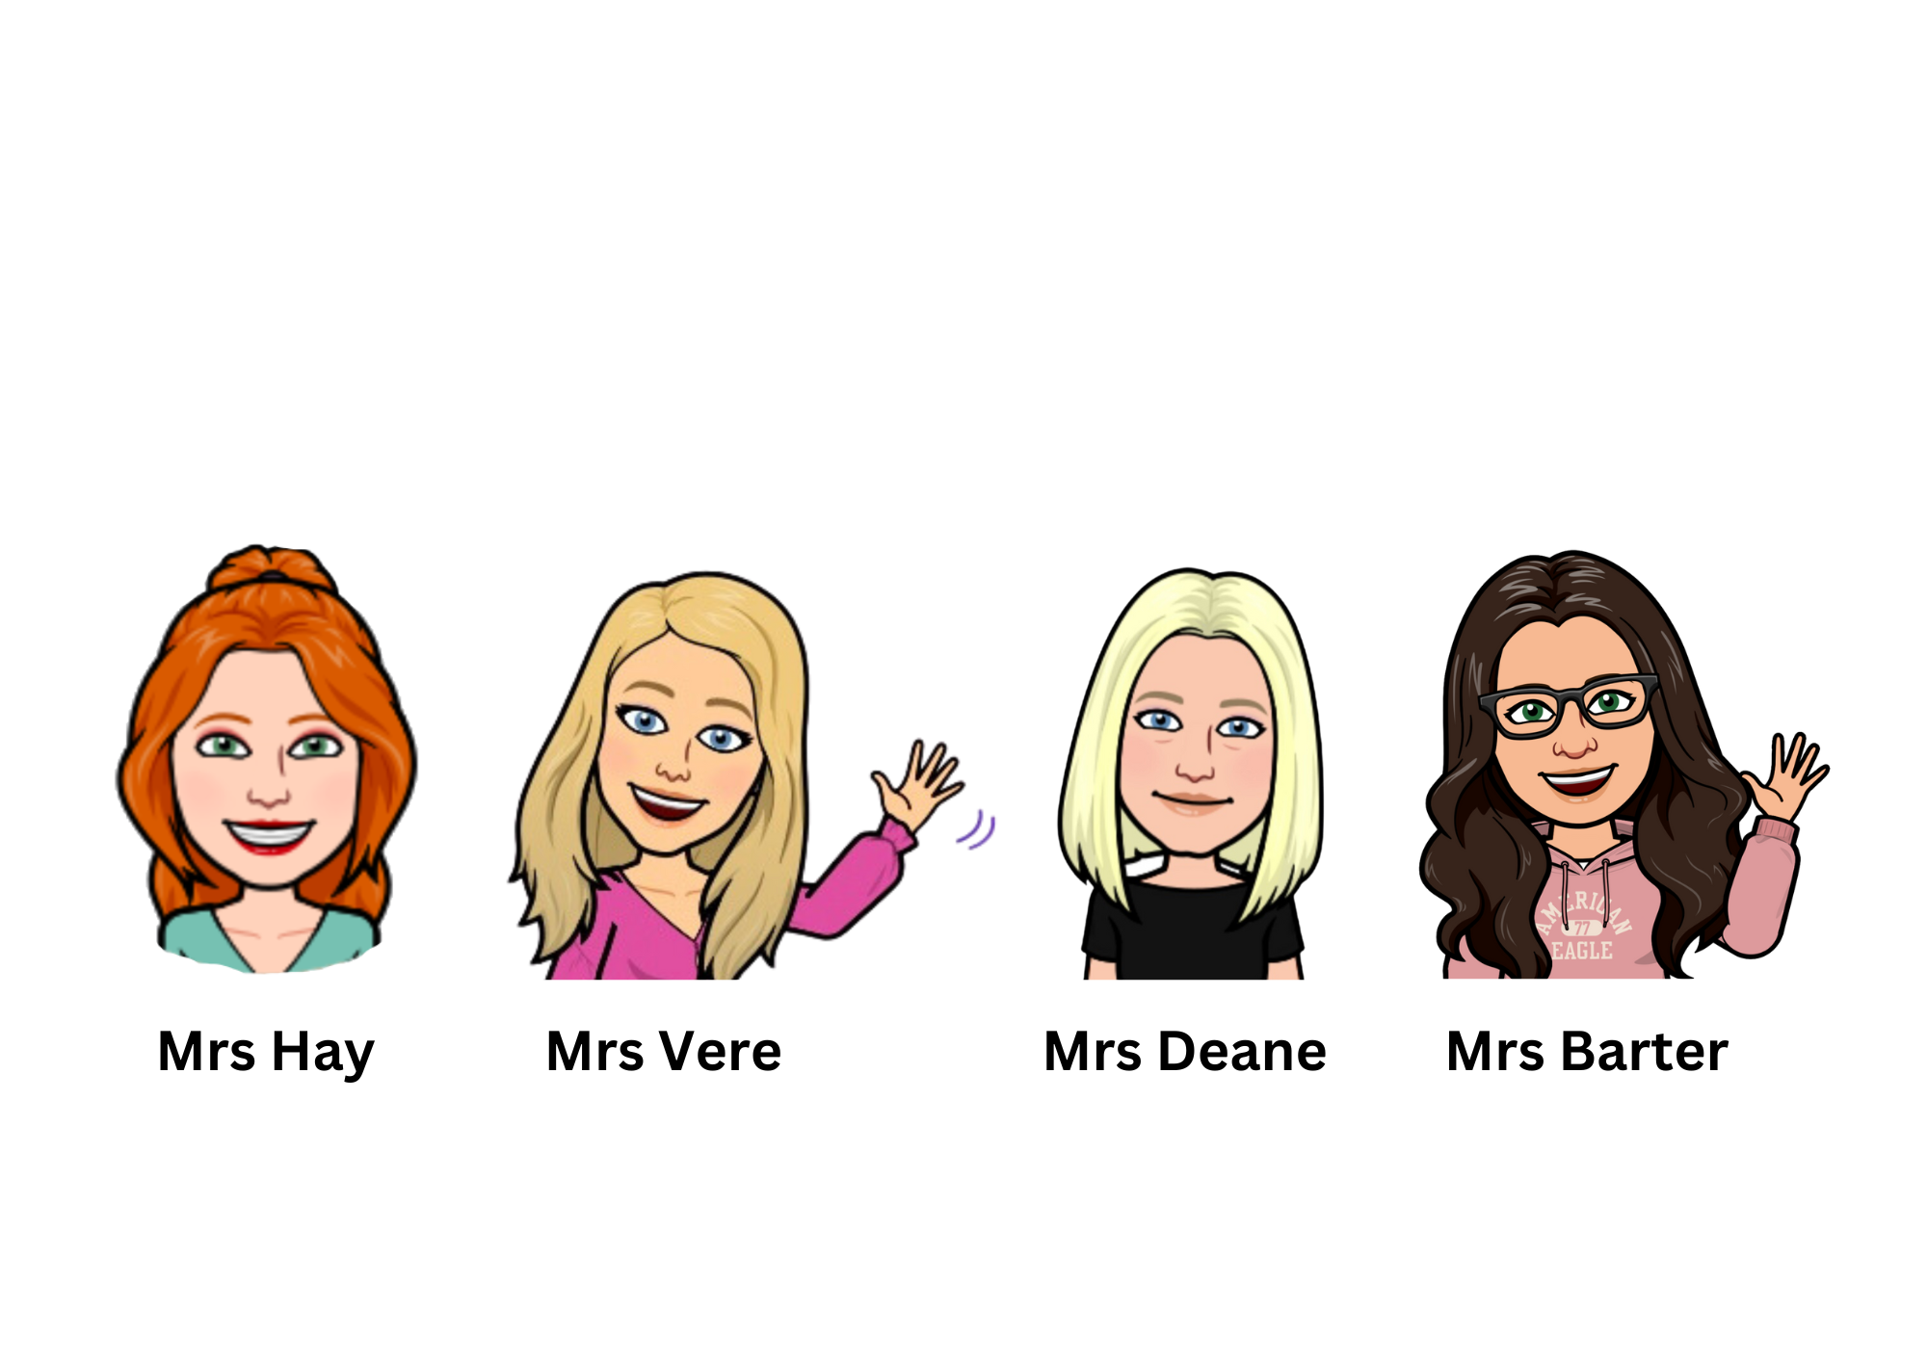
More Information
You can discover more at:
https://careers.paigntonacademy.org/

