Slide 1
APPRENTICESHIPS
Georgina Cleasby – Careers Adviser

Slide 2




WHAT IS AN APPRENTICESHIP ?
Combination of working and studying at college
Typically 4 days a week in work, 1 day in college
Available at different levels: Entry point varies!
Take between 1 to 4 years to complete for anyone over 16 and now inclusive for graduates
Includes a main qualification (NVQ) and a Diploma, or a Diploma covering the work and college criteria, Maths and English if not already achieved.
Levels 6 & 7 | Batchelor’s degree & Master’s
Levels 4 & 5 | Higher
Level 3 | Advanced
Level 2 | Intermediate

Slide 3
Funding, Salaries & Study
Earn while you learn! Wages start from £3.50 per hour, some apprenticeships salaried per year. Any costs met by the employer!
Paid 28 days holiday, must receive pay slips and a contract of employment
Any organisation with a pay bill in excess of £3 million must offer apprenticeships, they will have a digital account & pay a levy
Funding now available for graduates
Standards are replacing frameworks
Progression to Higher Education (university) now possible
At least 20% of the apprentice’s time must be allocated to study
Minimum age 16 – no upper age limit

Slide 4
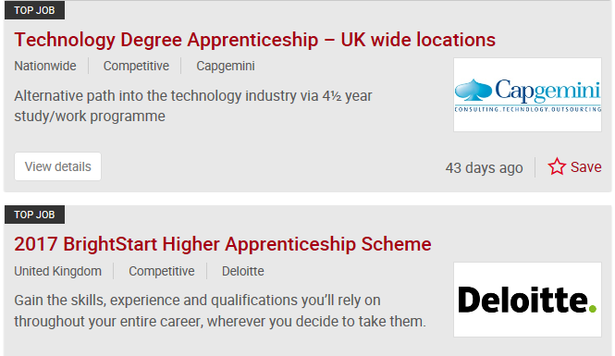
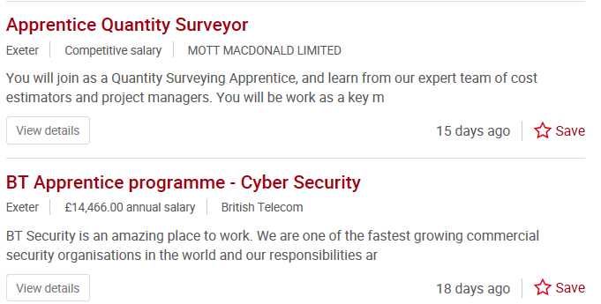
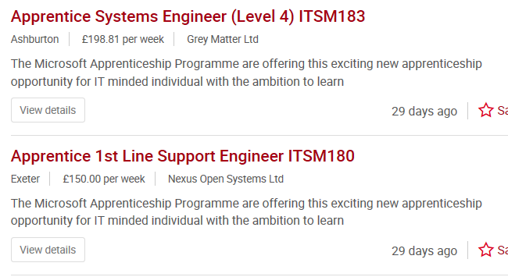
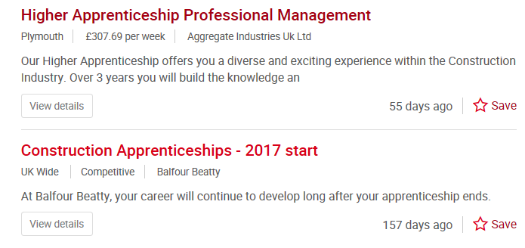

Slide 6
How do I find an Apprenticeship ?
Through someone you know who would be willing to take you on
By sending out letters and CV’s
By completing work experience/ volunteering within the sector
By completing a further education course within the sector before progressing into an apprenticeship
Contacting providers (a training organisation/ college who delivers apprenticeships)
Registering on the www.getingofar.gov.uk website www.prospects.ac.uk
Higher apprenticeships can be found on www.ucas.com & www.notgoingtouni.co.uk www.thescholarshiphub.org.uk
www.prospects.ac.uk

Slide 7
Questions?

